Slide 1


ULAVAR விவசாயி
“Putting Mother Nature in a Better Mood”

Slide 2
Introduction प्रस्तावना
Rice is the most important crop in India. It is widely cultivated in diverse ecologies and agro ecological zones. Management levels and production constraints vary spatially and temporally in these environments.
Therefore crop/location specific management practices are needed to increase productivity of Rice crop.
So this app will collect data from various sources and will display on a map view and will suggest farmers with the places with best fertility to grow rice and will suggest proper farming methods and places to buy proper crops and fertilizers.
This app will also show farmers about the nearby ration shops to buy crops, pesticides and shops for buying proper machinery. It will also be in multiple languages.
It will also provide them the information of nearby banks for loans and will also suggest them the best plan for their loan according to their economic condition.
The key feature of this app will be that it will be very user friendly and available in regional languages, so that people of rural areas who have lesser knowledge to use digital devices can use this app easily.
We will also have another feature where the farmer can add it's soil details using "Soil health card" received from govt labs to check whether rice is suitable for their land or which other crops can be grown. We will also provide information about hybrid crops that will increase their productivity and profits.

Slide 3
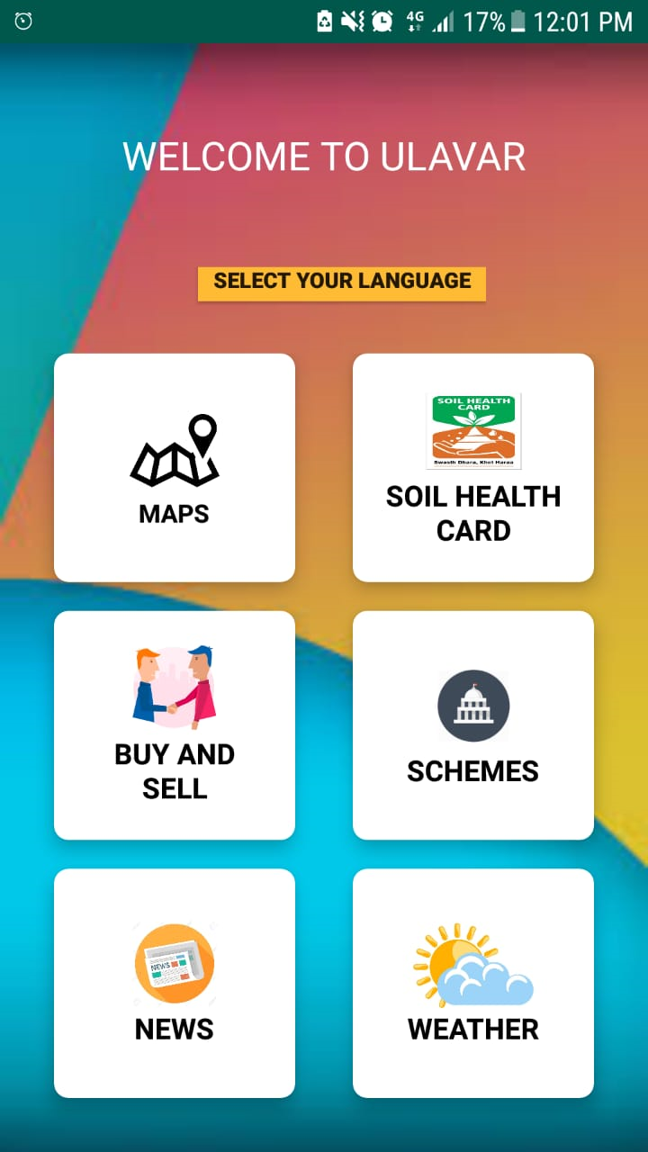
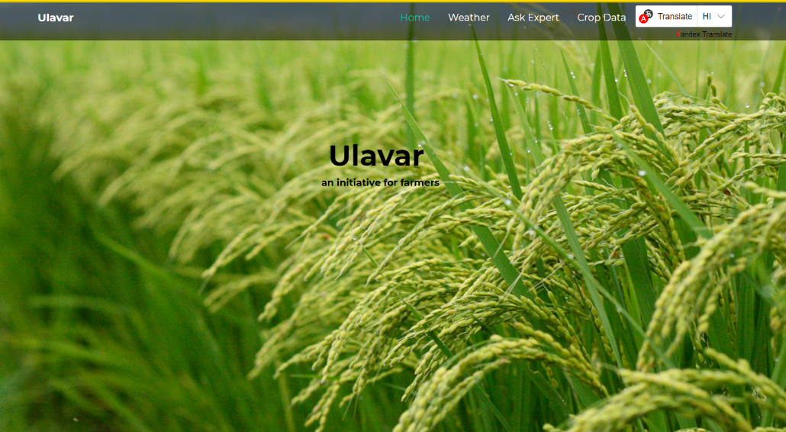
2 Platforms put forward :
Web Portal
Mobile Application

Slide 4
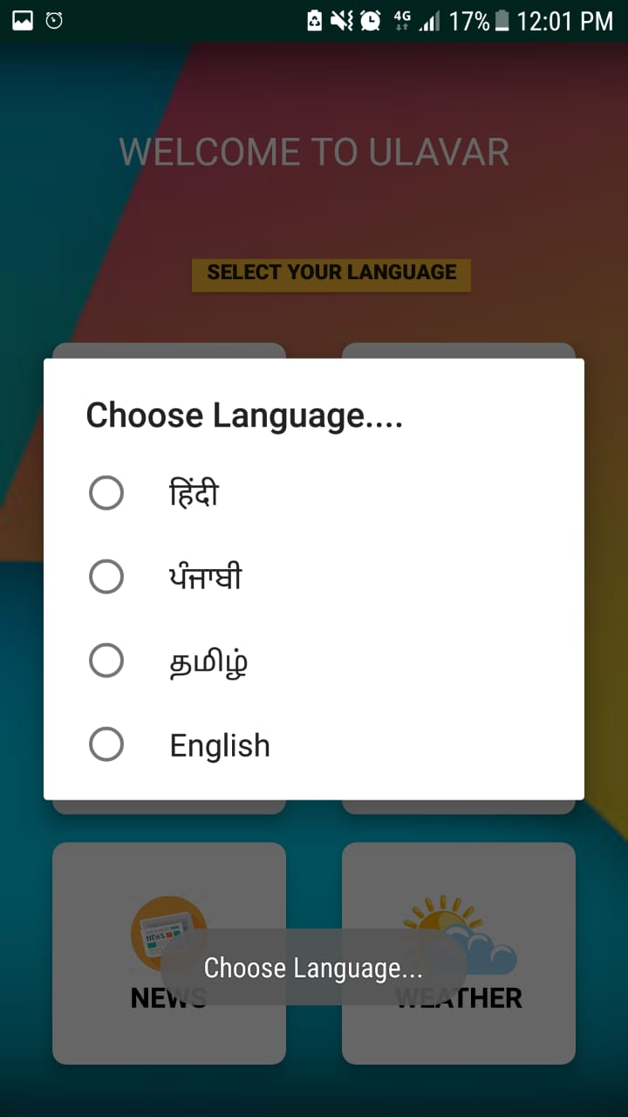
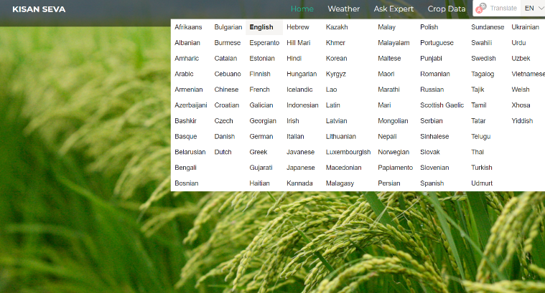
MULTI LINGUAL
बहुभाषी
Different languages to study
crop diversity.
English
Hindi
Tamil
Punjabi

Slide 5
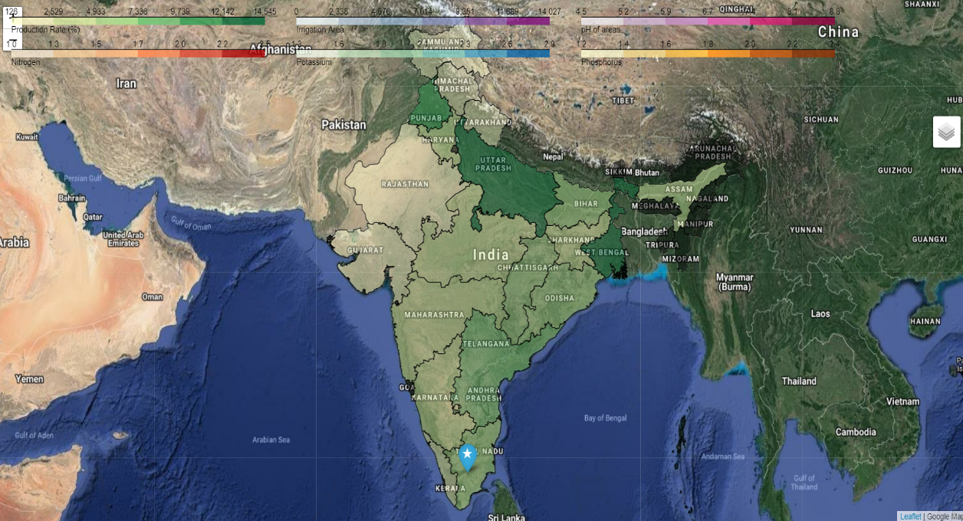
Folium
Open Source Software
Capture, Manipulate & Analyse Spatial or Geographic data.
Conclusion

Slide 6
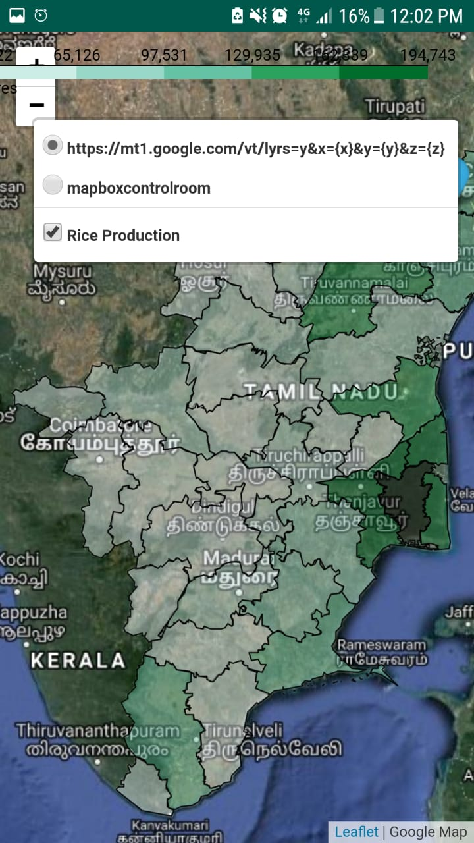

Slide 7
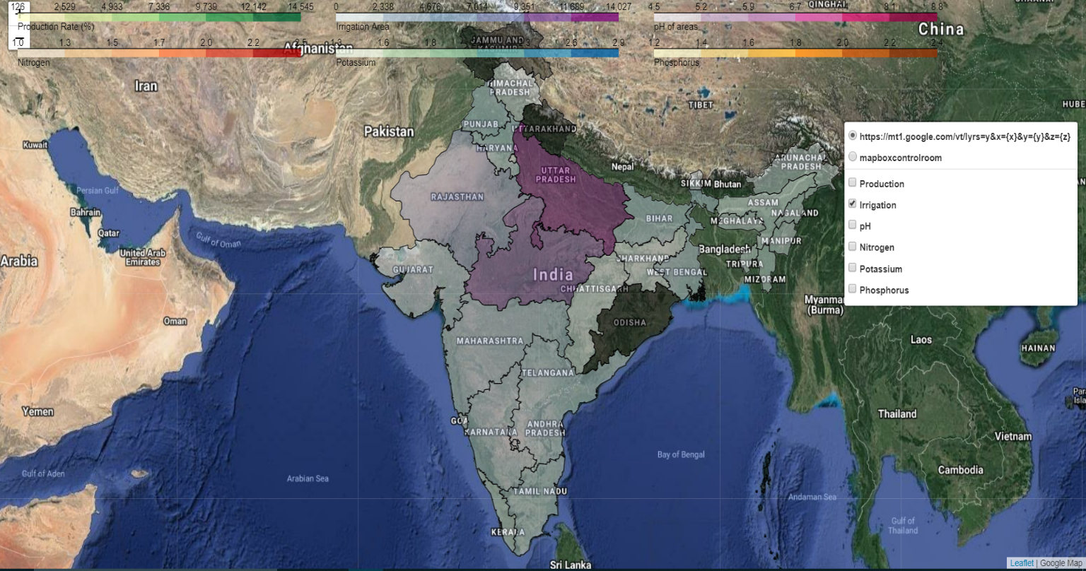

Slide 8
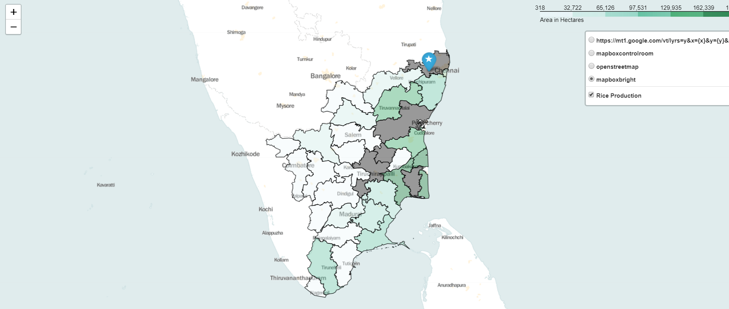

Slide 9

MAPS
GET DIRECTIONS,REVIEWS & INFORMATION…
Apprise about nearby banks for loans.
Provide details of various shops.

Slide 10
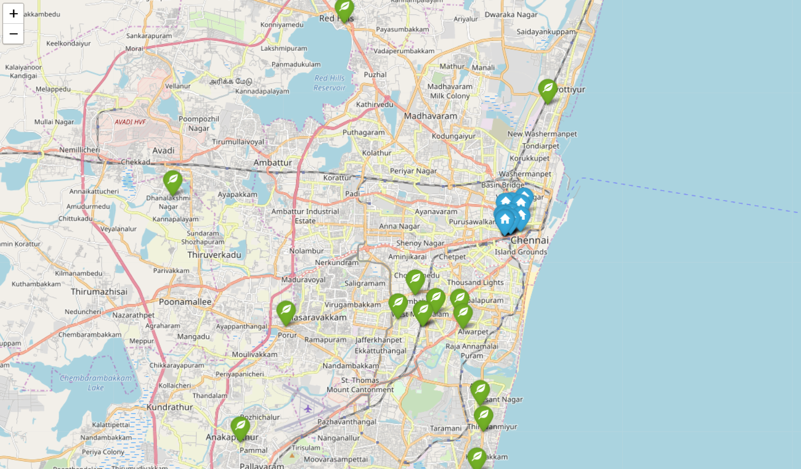

Slide 11
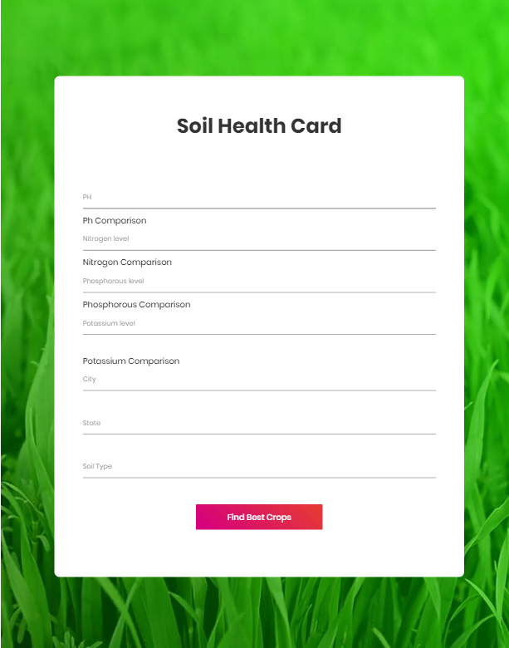

SOIL HEALTH CARD मृदा स्‍वास्‍थ्‍य कार्ड
“ मृदा का ज्ञान, समृध्द किसान ”
Track your sample
Enter details &
Get the best advice

Slide 12
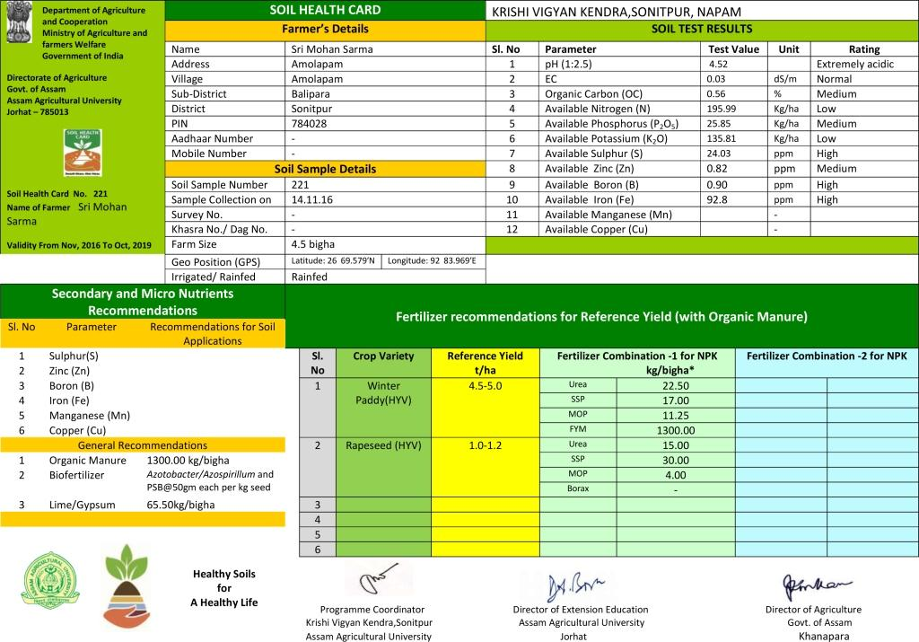
SOIL HEALTH CARD

Slide 13
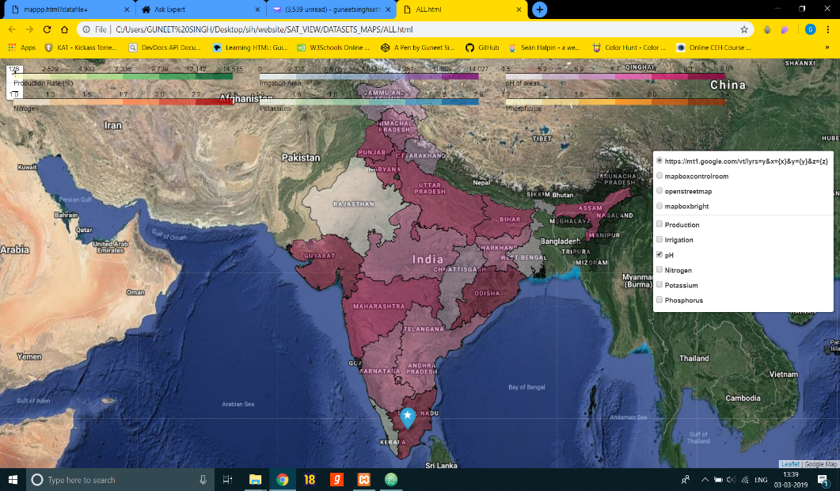
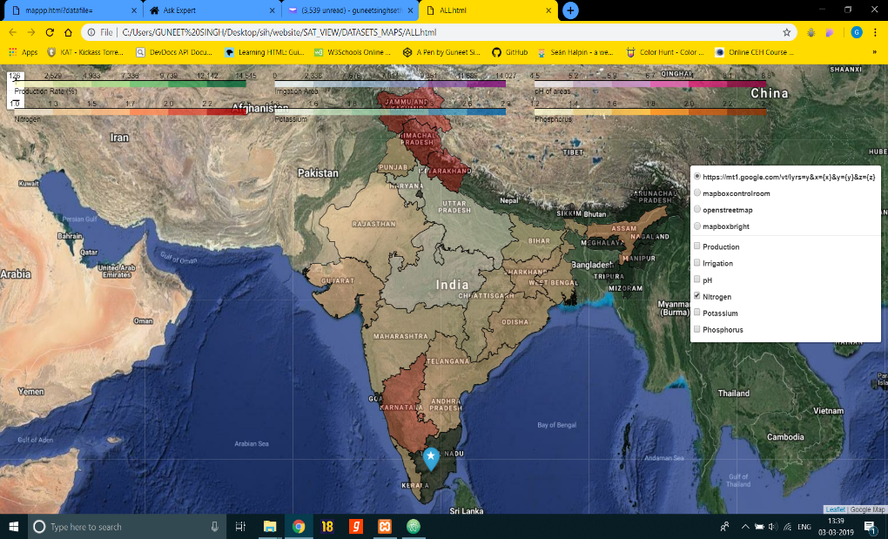
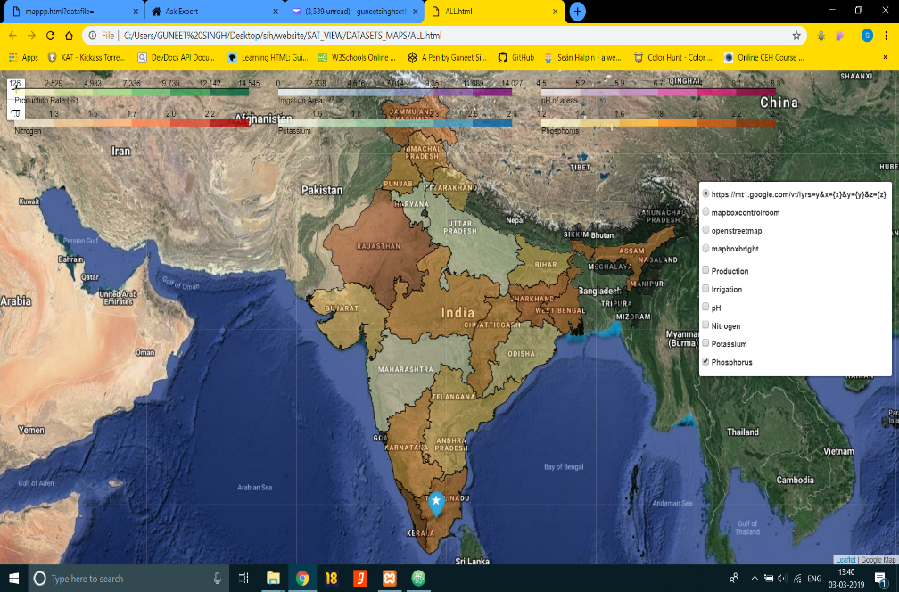
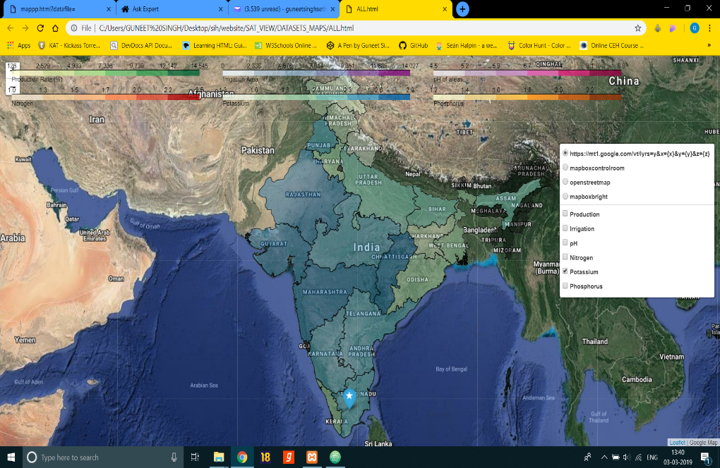

Slide 14
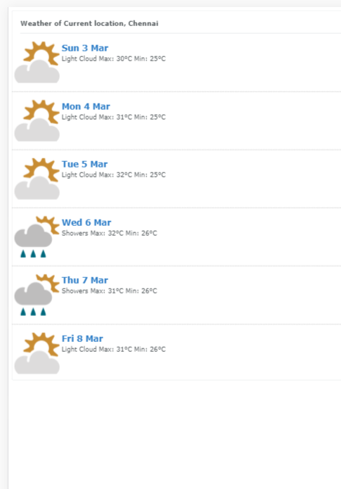
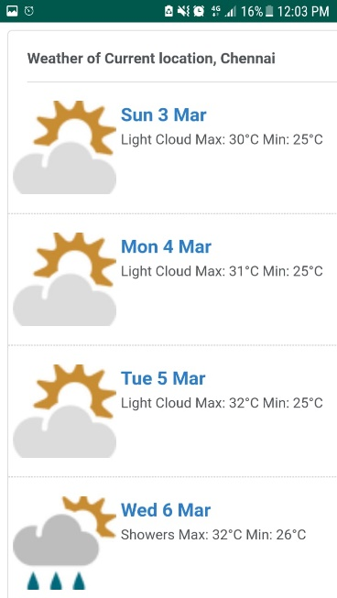
NEWS AND WEATHER समाचार और मौसम
New Ideas Arriving Daily…
Website
Android App
Up-to date news coverage
Latest Technologies – the Innovations lifting us up!
The most current &reliable 5-day weather forecast

Slide 15
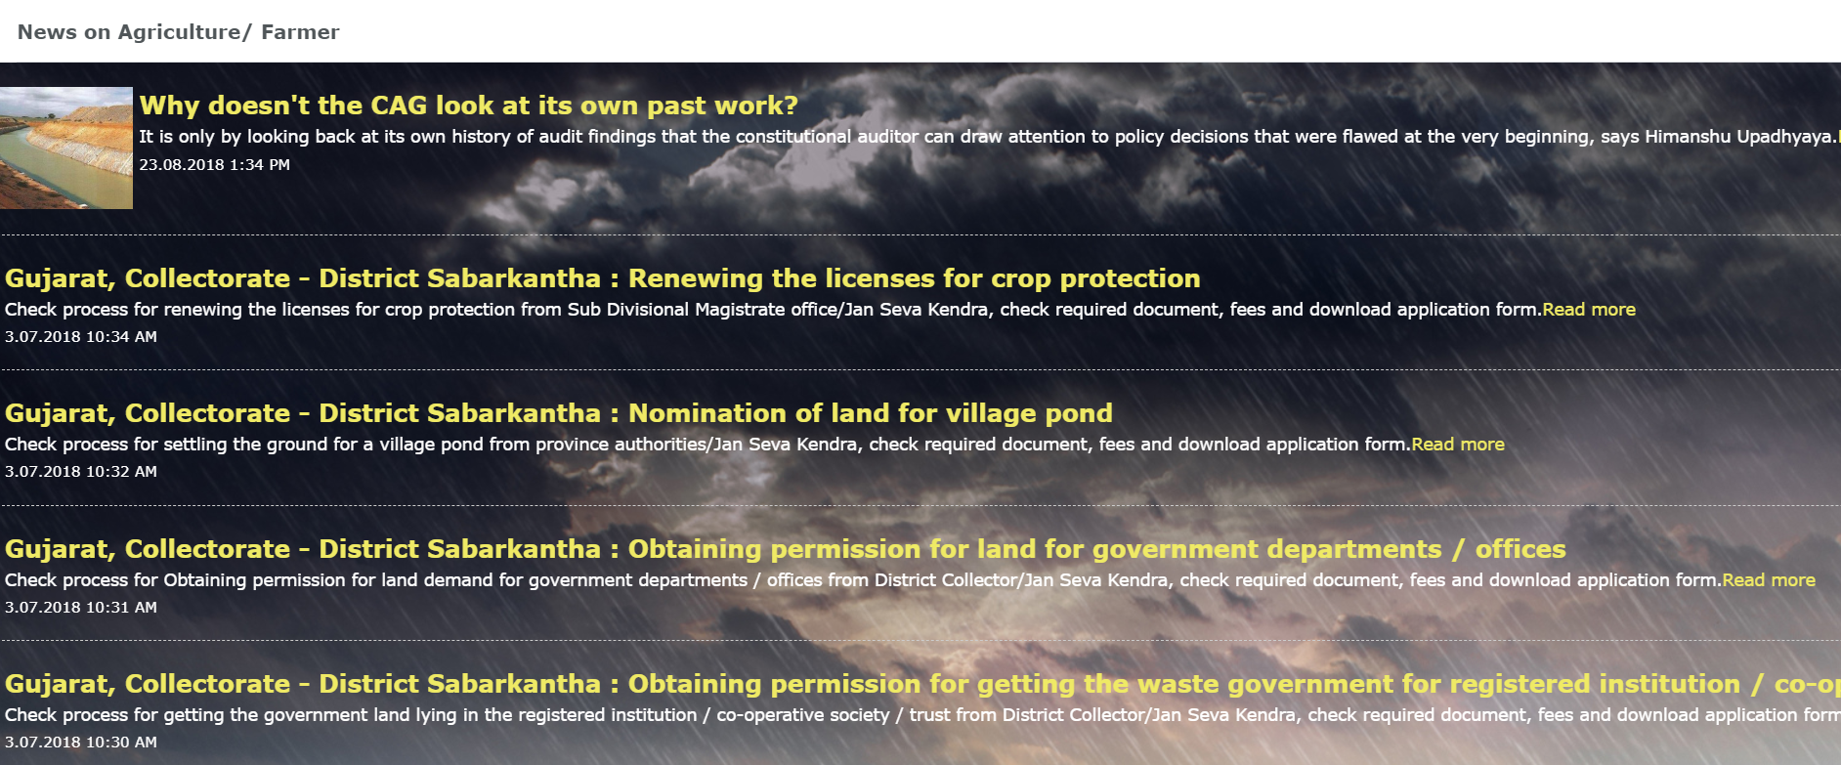

Slide 16
GOVERNMENT SCHEMES
Latest Govt. Schemes for the better knowledge of the farmers.

Slide 17
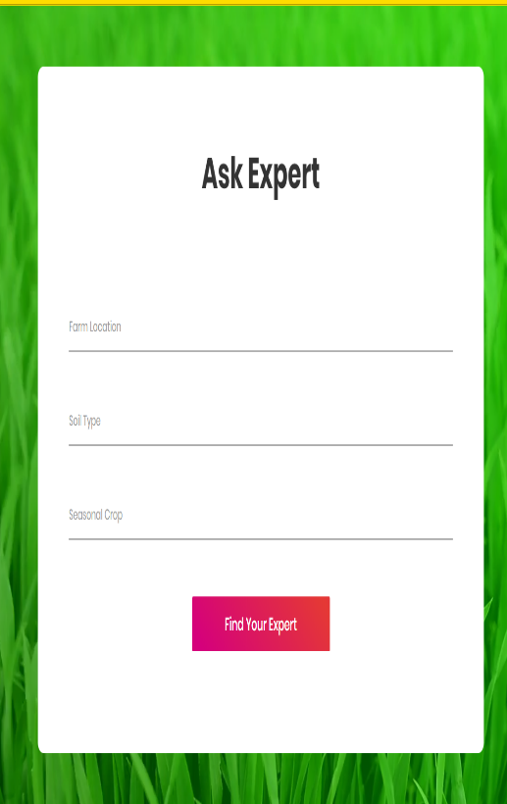
EXPERT ADVICE विशेषज्ञो कि सलाह
You’ve got questions, we’ve got answers..
Apply for Crop benefits.
Discover top verified experts and solicitor consultants on minimal cost.
Anticipated benefit of 1% to the government.

Slide 18
RENTALS
When you’re ready, we’re ready!
Option to rent your farming tools when not in use.

Slide 19
FUTURE SCOPE :
WASTE MANAGEMENT
HOME DELIVERY
A few clicks is all it takes..
In Got Pollution?
Be the solution.
Need more income?
Harvest your crop &
Think before you burn farm waste, there could be some use of it.
Seeds and more – delivered straight to your door
Right Store. Right Price.
Safe. Natural. Organic.

Slide 20
e-Auction
Help suppliers compete dynamically in real time for a buyer’s business.

Slide 21
THANKYOU..!

